Slide 1
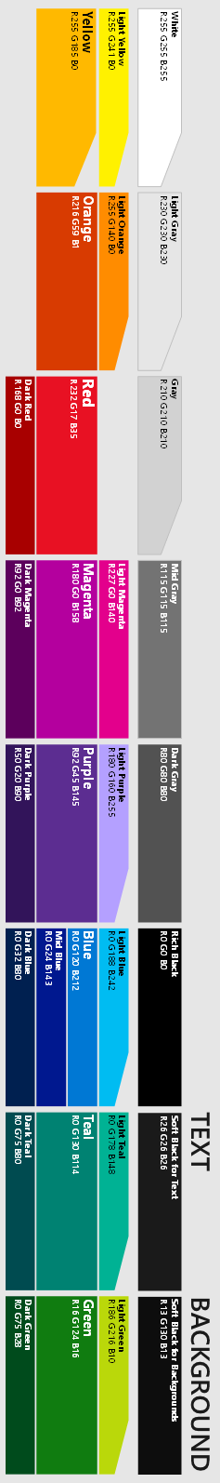


Power Platform – Model Driven Apps Overview
0
Chris Huntingford
Partner Technical Architect - Microsoft
AKA.MS/HackAtSpeed |HackPacks | Model Driven App Training

Slide 2
Agenda
09:00 - 09:30 : Welcome & Introductions
09:30 – 10:30 : Common Data Service & Demonstration
Entities, Fields & Relationships (Demo)
10:30 – 10:45 : Break
10:45 – 11:15 : Security Management
11:15 – 11:45 : Lab 1 – Data Modelling & Review
11:45 – 12:00 : Data Flows (With Short Demo)
12:00 – 12:30 : Lab 2 – Create your own CDS Environment & Use Data Flows
12:30 – 13:30 : Lunch
13:30 – 14:00 : Model Driven App Components
Forms, Views & Charts (Demo)
14:00 – 14:45 : Lab 3 – Configuring Forms, Views & Charts
14:45 - 15:00 : Break
15:00 - 15:30 : Model Driven Apps & Business Process Flows
15:30 - 16:15 : Lab 4 – Build Model Driven Apps & Business Process Flow

Slide 3
High-productivity application platform as a service
A platform as a service that allows non-developers and developers to rapidly build apps without code
Market size
Gartner predicts PowerApps and Microsoft Flow’s total addressable market to be over $14.3 billion in 2019, and it is projected to grow to $32.4 billion in 2022.
>2X
$14.3 billion
$32.4 billion
2019
2022 projected
Gartner Market Statistics, 2019.
Notes:
In the next 5 years more apps will be built than in the last 40 combined.
65% of enterprise applications will be of the low-code no-code variety by 2024.
This market is growing fast - Application Platform as a Service
In 2022 it will have more than double since 2019
And Gartner predicts that the PowerApps and Flow addressable Market in 2022 will be over 32 billion

Slide 4


“Microsoft 365, Dynamics 365, and the Power Platform, on top of what we’re doing with Azure, is the core of what we are doing as a company.”
--Satya Nadella
Notes:
That’s why from the top down this is a strategic opportunity for our business and market that we want to be leaders in.

Slide 5
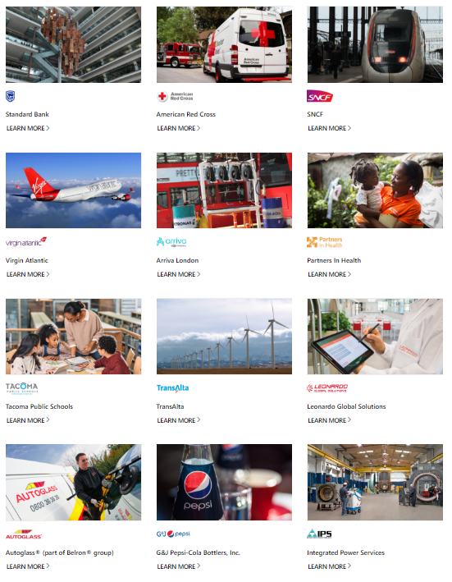
Power Platform Momentum
$500M+ FY19 revenue, >100% growth year/year
>2.5M Monthly Active Developers on the Power Platform
>700% growth in PowerApps production apps
>200k Monthly Active Customers on the Power Platform
>10 PB of data uploaded to Power BI each month
>4 Billion Flow runs each month
https://powerapps.microsoft.com/en-us/customer-stories/
Notes:
Chris
Numbers don’t lie - Lots of great customer wins to speak of, alongside growth in # of PowerApps, data in PowerBI, # of Flow Runs and MAU

Slide 6
Business users want solutions to their challenges
Businesses gather data
…but few make it actionable.
Workforce requiring multi-device capability
The number of enterprises with more than 100 terabytes of unstructured data has doubled since 2016.¹
Only 32% of those companies have succeeded in analyzing that data in any actionable way.¹
Over 72% of U.S. workforce will be mobile workers by 2020.²
Mobile > PC
Apps can be expensive
Line of business decision makers are critical to success
Time spent on mobile is now significantly higher than time spent on PCs.³
The average cost to produce an app is $171,450, but can quickly increase beyond $350,000.⁴
81% of technology projects influenced by line of business decision makers⁵ who are looking to create their own solutions.
Forrester Research, Inc., “Predictions 2018: The Honeymoon For AI Is Over.” November 2017.
IDC, “U.S. Mobile Worker Forecast, 2015-2020.” June 2015.
KPMG, “Internet Trends 2017.” 2017.
Clutch survey, 2017.
Microsoft, 2017.
Notes:
Chris
Businesses have spent years gathering data. The number of enterprises with more than 100TB unstructured data has doubled since 2016.
Very few of those businesses analyse that data and make it actionable.
The workforce all over the globe require multi device capacity and collaboration.
Time spent on mobile devices is significantly higher.
Creating applications can often prove to be time consuming and expensive.
Line of Business decision makers are critical to the process. 81% of projects are influenced by LoB decision makers that are looking to create their own solutions.

Slide 7
Transforming a business can be challenging
Time to Market
Business/ IT Alignment
Lack of Insights
Total cost of ownership
Time & Resource
constraints
Budget
constraints
“Shadow IT”
governance
No BI integration
Legacy system
maintenance
Security &
Compliance needs
Paper
processes
Complex
processes
Changing Business
expectations
Lack of tracking & measuring performance
Leverage existing
technology
Line of business decision makers are critical to success
61%
81%
of technology projects funded by LoB
of technology projects influenced by LoB
Notes:
Chris
What is on top of mind for your customers? – Their customers are going digital… they’re trying to be agile and provide a great customer experience quickly.
There is always friction between business expectations and what IT can deliver quickly.
More & more investment for technology is coming from business users and through business priorities.
https://knowledgecompass.com/line-of-business-technology-budget-responsibilities/
https://www.ca.com/content/dam/ca/us/files/product-brief/how-to-survive-and-thrive-in-the-application-economy.pdf
What if you had a solution that can help address these challenges addressed for both the business and the technology team.

Slide 8
Organisations deal with countless
manual, paper & complex processes
Only so many problems can be solved with
off-the-shelf SaaS
Sometimes…
There’s just not “an app for that”
Custom development & maintenance
is time consuming and costly
Everything else…
is a missed opportunity to optimise
Notes:
Developing customer software to if often privileged for a handful of business apps, as building customer applications to meet enterprise requirement has its own challenges :
Time consuming : developing of a customer mobile app can take anywhere from 3 to 12 months for a single project, depending on the app complexity (source ADT magazine). This becomes challenging in situation where LOB wants to respond and implement improvements quickly
Cost prohibitive : driven by a shortage of specialized resourcing : 94% of the enterprise organization have a shortage of App developers, as a lot of App developers still prioritize consumer facing Apps (Source ADT Magazine & Vision Mobile)
Off-the-shelf SaaS can only solve so many problems
Most ‘off-the-shelf’ SaaS solutions are targeted as solving specific problems` and often come with their own mobile App. These apps provide a mobilize experience of these specific SaaS solutions.
However, the onslaught of information from these individual often disconnected SaaS services will virtually make it impossible for workers to follow everyday business processes. More and more business process will span multiple applications and SaaS services. (Source: eWeek)

Slide 9
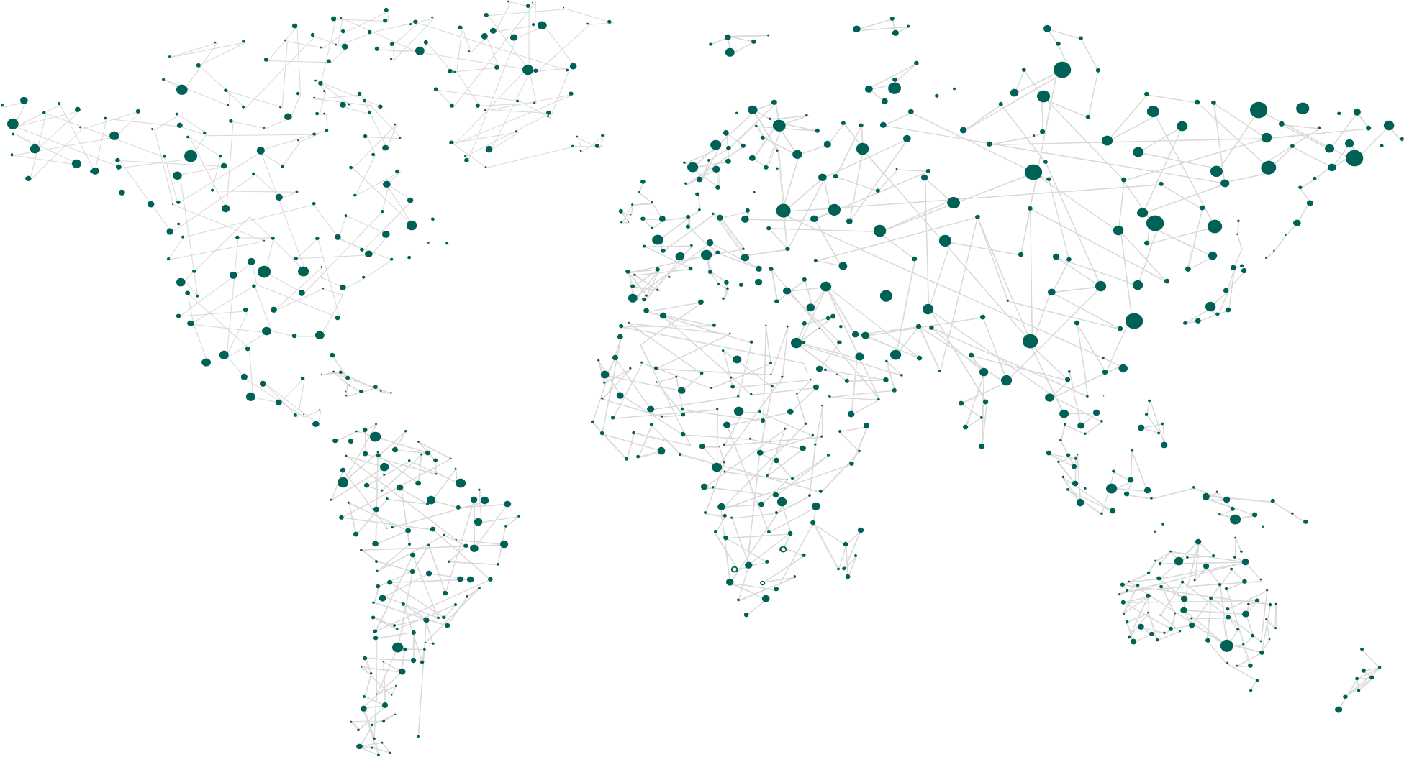
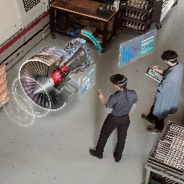
Digital Feedback Loop
Empower people
People
Intake fins cambered for proper induction
Calibrating torque rod arm at 8.5 inches
Exhaustion system error reported to manager for further inspection
Compression system functioning at full capacity
Combustion system functioning at full capacity
Error detected in exhaustion system
Tech intensity
Engage customers
Transform
products
Customers
Products
Operations
Optimize operations
Notes:
When we talk about the digital feedback loop, we’re talking about the four pillars of a business:
1- the people who make up that business
2- the products that business sells,
3- their operations and
4- the customers that they have. <click>
All four of those pillars are constantly providing data of which there is an opportunity for us to act. <click>
By better engaging our customers <click>
Transforming products, optimizing operations, and empowering people to do more <click>
This is the business intelligence dilemma for which we are trying to solve. <click>

Slide 10
Digital Feedback Loop
Empower people
Engage customers
Transform
products
Optimize operations
Notes:
About 8 years ago, we began to lay down a planet-scale footprint of data centered capacity. The ability to catch every piece of telemetry information coming out of every aircraft engine, every tweet, every time someone comes to the website, all of this information, and providing a place where it can be captured and stored in privacy, secured in compliance with the nation or state regulations where the data has sovereignty. <click>
We invested heavily at the bottom where the changes occur, where the data is increasingly coming out of everything. Then on top of that, we built an intelligence platform and an application platform in Azure that allows you take all of that data, turn it into intelligence, and then act intelligently to predict and proact. <click>
Then on top of that, we built the Power Platform (Power BI, Power Apps, Microsoft Flow, the Common Data Service), that allow non-professional programmers to harness data. <click>
Then on top of that, we built Office 365 and Dynamics 365, which are out of the box applications that infuse data and intelligence into business processes. <click>
On top of that, we built AppSource, allowing all of you, many of our partners, to create solutions that target specific industries or specialized business process that we do not target ourselves in Office or Dynamics. <click>
And if all that wasn’t enough, coming into the bottom of this “value creation funnel”, is a collection of data sources that Microsoft has like LinkedIn and Bing and other sources to infuse, enrich and augment your data.
And so this picture, layered on top of that digital feedback loop, is that platform that we’re going to talk a lot about today, with a focus on the Power Platform in particular. <click>

Slide 11
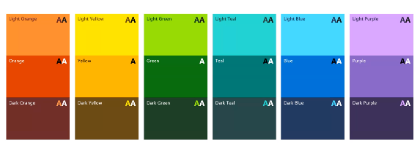


AppSource (ISV)
Office 365 + Dynamics 365
Power Platform
Azure
Data
Microsoft Graph
Notes:
About 8 years ago, we began to lay down a planet-scale footprint of data centered capacity. The ability to catch every piece of telemetry information coming out of every aircraft engine, every tweet, every time someone comes to the website, all of this information, and providing a place where it can be captured and stored in privacy, secured in compliance with the nation or state regulations where the data has sovereignty. <click>
We invested heavily at the bottom where the changes occur, where the data is increasingly coming out of everything. Then on top of that, we built an intelligence platform and an application platform in Azure that allows you take all of that data, turn it into intelligence, and then act intelligently to predict and proact. <click>
Then on top of that, we built the Power Platform (Power BI, Power Apps, Microsoft Flow, the Common Data Service), that allow non-professional programmers to harness data. <click>
Then on top of that, we built Office 365 and Dynamics 365, which are out of the box applications that infuse data and intelligence into business processes. <click>
On top of that, we built AppSource, allowing all of you, many of our partners, to create solutions that target specific industries or specialized business process that we do not target ourselves in Office or Dynamics. <click>
And if all that wasn’t enough, coming into the bottom of this “value creation funnel”, is a collection of data sources that Microsoft has like LinkedIn and Bing and other sources to infuse, enrich and augment your data.
And so this picture, layered on top of that digital feedback loop, is that platform that we’re going to talk a lot about today, with a focus on the Power Platform in particular. <click>

Slide 12
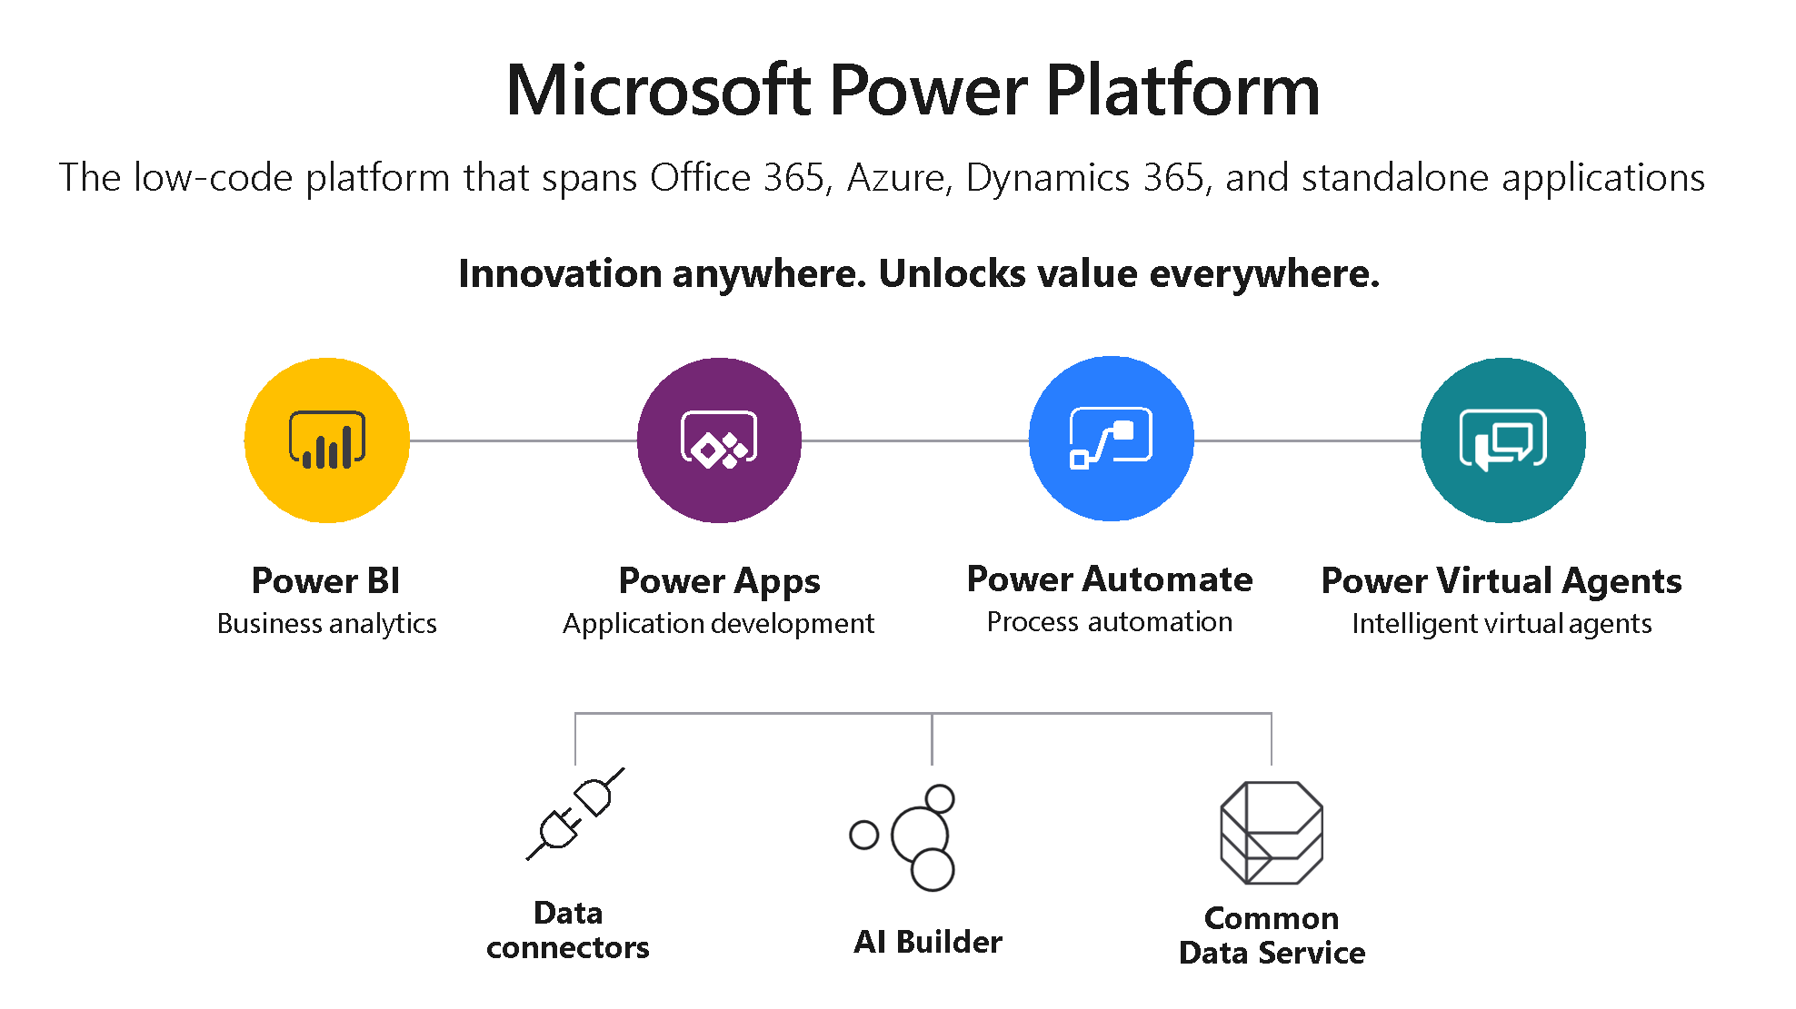

Slide 13
The Common Data Service

Slide 14

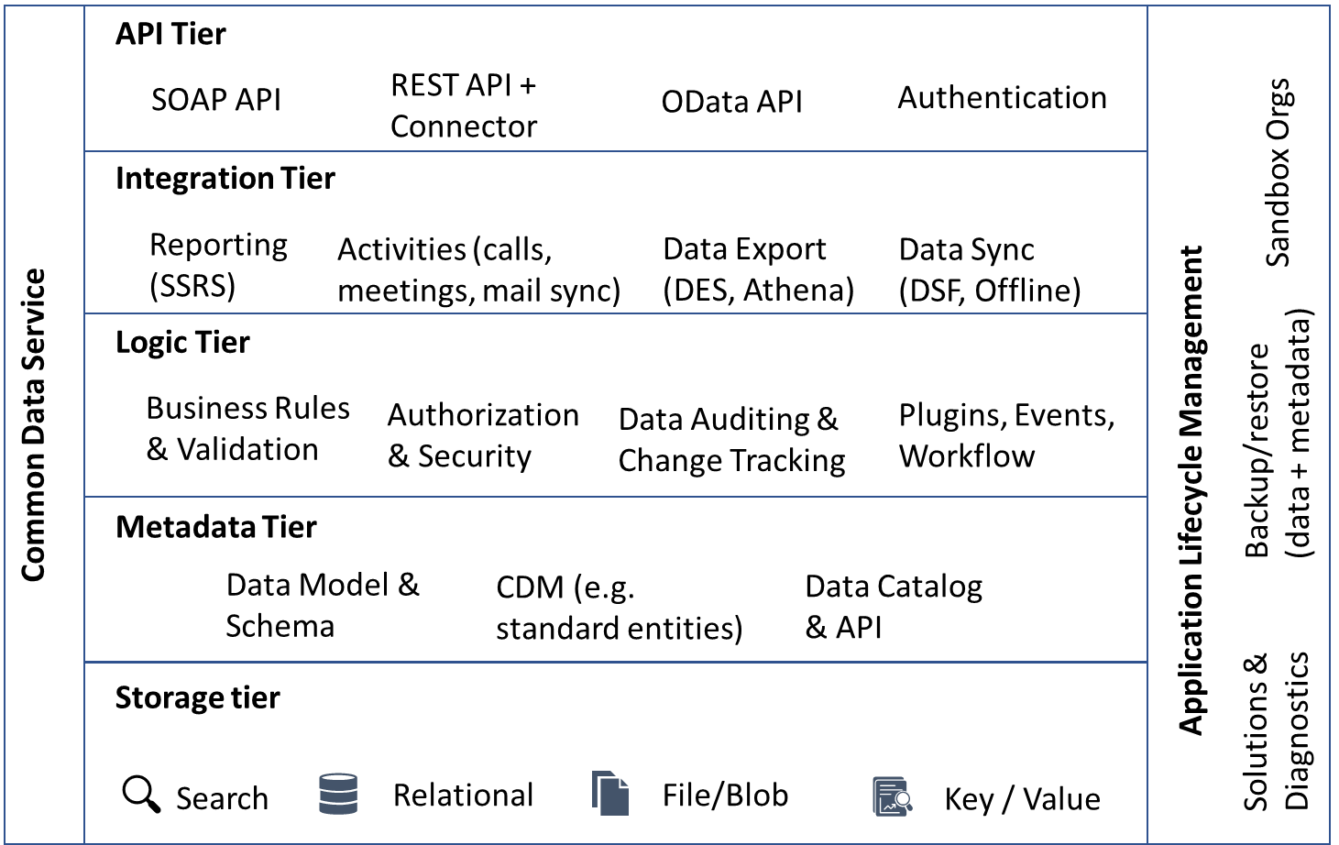
Common Data Service (CDS): low code backend & database
More than a database - “out-of-the-box” backend for apps
Supports relational data, no-SQL, blobs & search indexing
Security, business logic and rules
Jumpstart with the Common Data Model
Includes Dynamics, Office, and Azure data, augmented by partners
Notes:
Chris
Speaking of the Common Data Service, it is the “out-of-the-box” database for your apps. It is a fully managed, secure, database, that has Microsoft data from Dynamics 365, Office 365 and Azure pre-populated. It also supports the Common Data Model, which includes well defined schema for various industries or verticals.

Slide 15
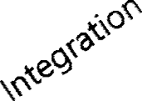

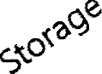
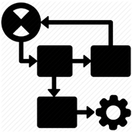
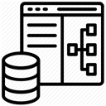
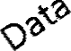





























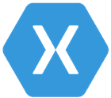

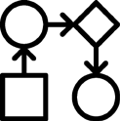
Relational databases
Eventing
Catalog and discovery
Files and blobs
Log files
Webhooks
Jobs
Modelling
Reporting
Semi-structured data
Business Rules
Calculated & Rollup fields
Duplicate Detection
Data validation
Search and Find data
Plugins
Data export
Common Data Model
Workflows
Data lake

Slide 16

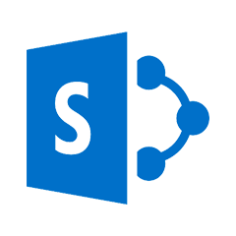










Power Platform – With Dynamics 365
Office 365
Business Process Flow
Automation & Governance
Model Driven Apps
Marketing
Sales
Service
SharePoint
Flow
FinOps
URS
Talent
Power BI
Canvas Apps
Field Service
Business Logic Layer
Common Data Service for Apps
Core Entities
Data Integration
Custom Entities
Business Rules
Workflows
Security
Plugins
Azure Services

Slide 17
Power Platform – With Dynamics 365
Office 365
Business Process Flow
Automation & Governance
Model Driven Apps
Marketing
Sales
Service
SharePoint
Flow
FinOps
PSA
Talent
Power BI
Canvas Apps
Field Service
Business Logic Layer
Common Data Service for Apps
Core Entities
Data Integration
Custom Entities
Business Rules
Workflows
Security
Plugins
Azure Services

Slide 18
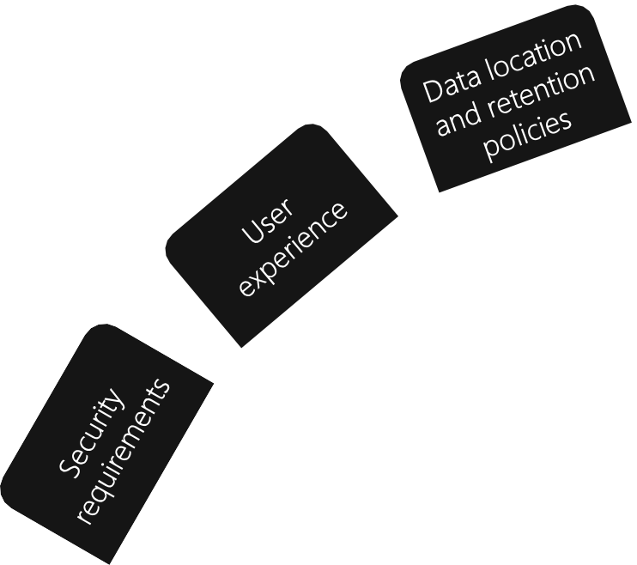
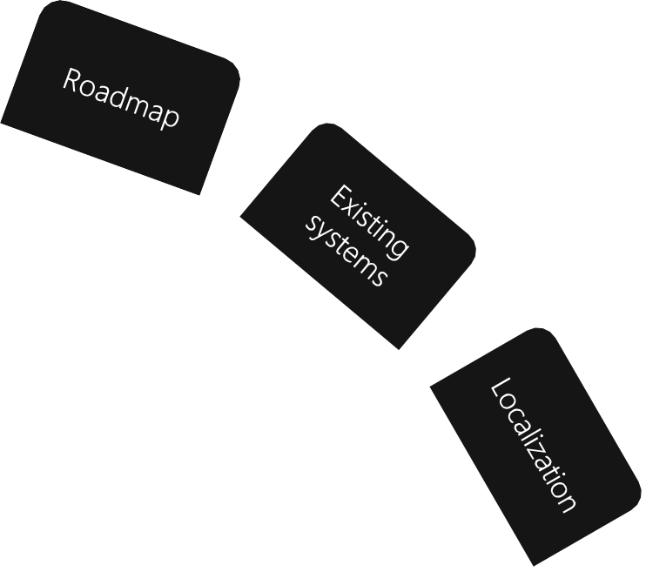

Self service reporting needs

Slide 19

Customers
System Integrators
SIs: Package together ISV solutions and customize to deliver
AppSource
AppSource: Delivery mechanism for Industry Solutions and/or Apps and Microsoft Solution Accelerators
3rd Party Connectors
ISV
ISV
ISV
ISV
Industry ISV
ISV: Horizonal ISVs extend solutions
Industry ISV Solution: may stand alone or OEM other industry or horizontal apps
Industry ISV
Industry ISV
Microsoft Industry Solution Accelerator
Microsoft Industry Solution Accelerators: package of data model, relevant business processes, Power BI dashboards, and sample data
Microsoft Industry Standard CDM
Expanding to strategic industries, including, Healthcare, Non-profit ,Education, Finance and Retail
https://aka.ms/cdmindustry

Slide 20
Common Data Service & Environment Setup Demonstration

Slide 21
Entity Management

Slide 22

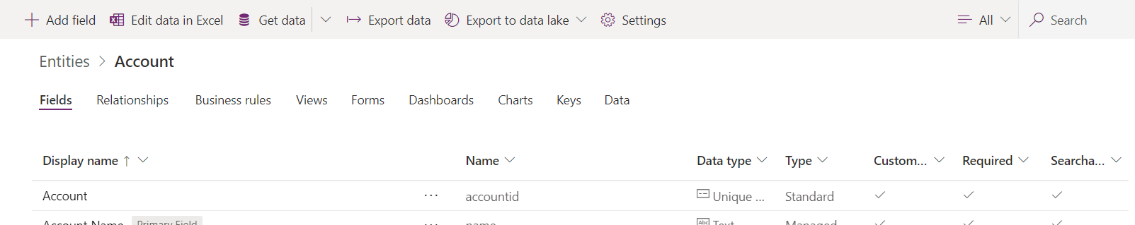
An Entity is a container for various functionality that is exposed through the Application layer.
Examples of this are:
Entity
Fields
Relationships
Business Rules
Views
Charts
Security
Data

Slide 23
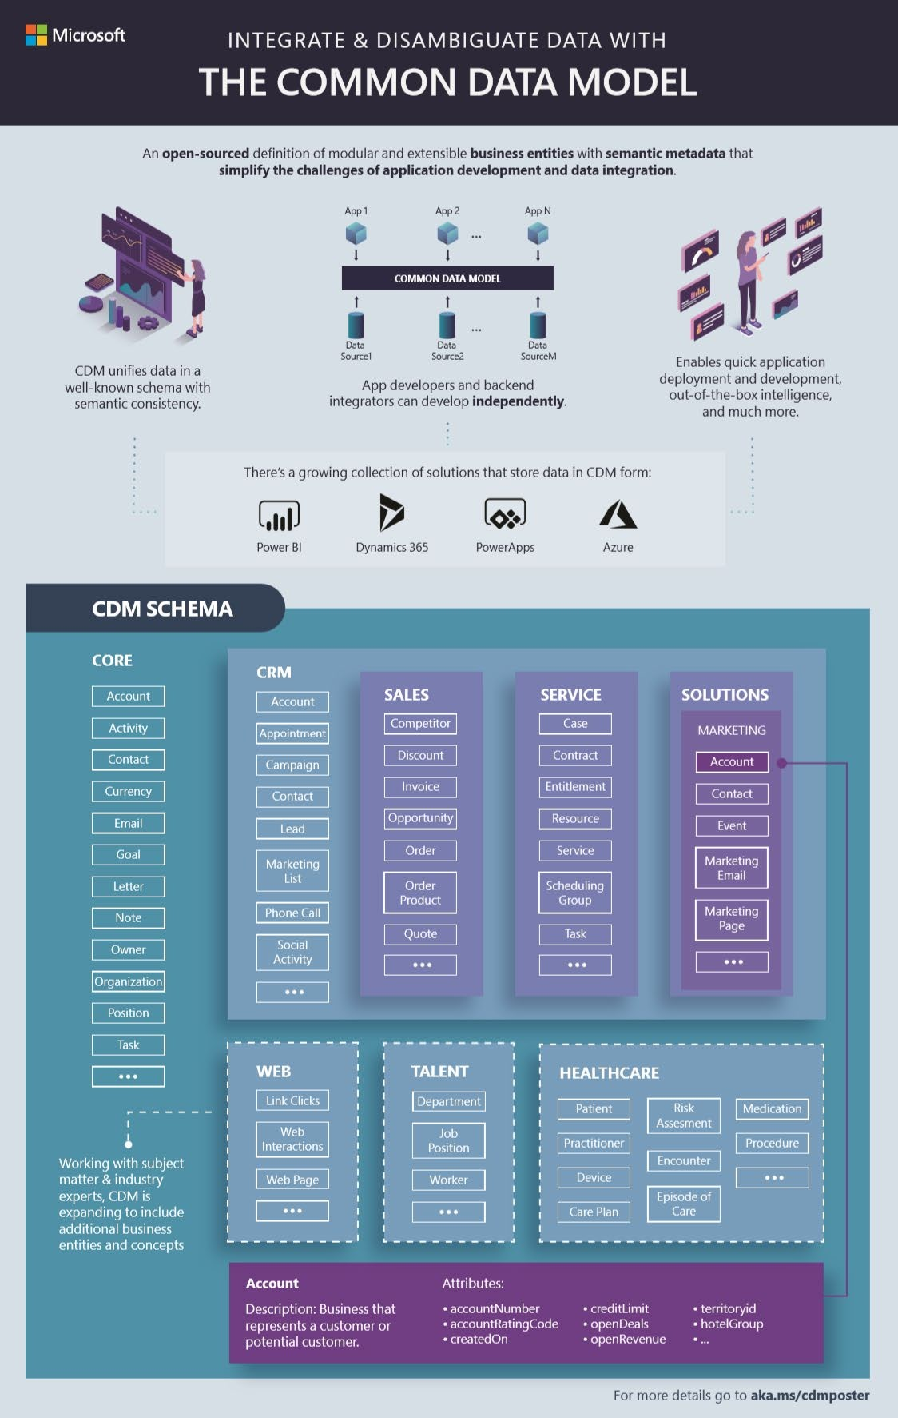
A shared data model allows applications and data integrators to interoperate via a unified definition of data
CDM includes a rich metadata system with standard entities, relationships, hierarchies, traits and more
Originated from Dynamics 365 / CRM apps, open- sourced in GitHub with over 260 standard entities
Multiple systems and platforms implement CDM today
Internal and external partners including CDS, Power BI dataflows, Azure Data Services, Informatica and more

Slide 24


▪
▪
▪
▪

Slide 25





Inspections
▪
Building Owners
Permit
Notes
▪
▪
Plans

Slide 26
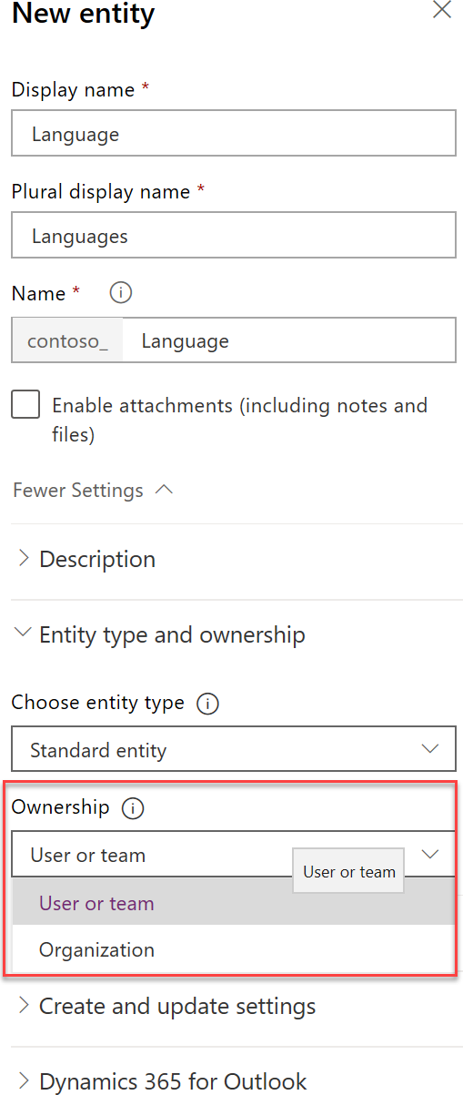





User / Team
Organisation
▪
All records have an owner
Record owned by organization
▪
Supports access levels
All or nothing access

Slide 27
Scenario – Knowledge Assessments
Assessments with one or more questions
Track scores of users who take the assessment
Allow users to provide feedback on the assessment

Slide 28
Knowledge Question
Feedback
Knowledge Assessment
User
Knowledge Test Result

Slide 29
Entity Creation Demo

Slide 30
Fields

Slide 31
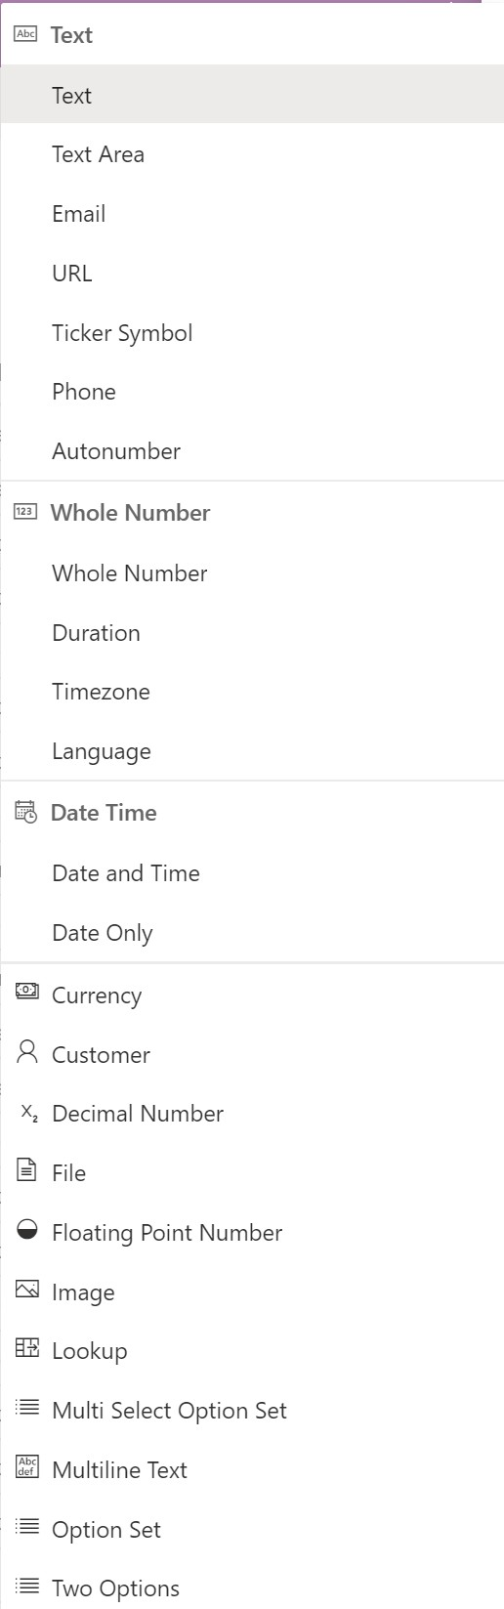


▪
▪
▪
▪

Slide 32


▪
▪
▪
▪
▪

Slide 33
Migrating Legacy Data
“CDS is starting to look exactly like our legacy system with
all the old data we are bringing over…”

Slide 34



Only stores label and value
Localization built-in
Filtered by developer script
Treated as solution component
No built-in way to retire
UX works to about 400 items
Stores as whole number
Can store other data
You build localization
Filter by views and security
Treated as reference data
Supports inactive state
UX scales to lots of items
Stores as entity reference

Slide 35
Data Type | Simple | Calculated | Rollup
Single Line of Text | X | X
Multiple Lines of Text | X
Whole Number | X | X | X
Floating Point | X
Decimal | X | X | X
Currency | X | X | X
Date Time | X | X | X
Option Set/Two Options | X | X
Multi-Select | X

Slide 36



Calculated on retrieve of record
Read only field
Record fields and parent fields
Can include rollup fields in calculation
No OOB calculated fields
Value stored on record, scheduled update/on-demand
Read only field
1:N only, fields on child records
Can rollup calculated fields
Can use hierarchy of related records
Can filter across related entities

Slide 37
Field Creation Demo

Slide 38
Relationships

Slide 39
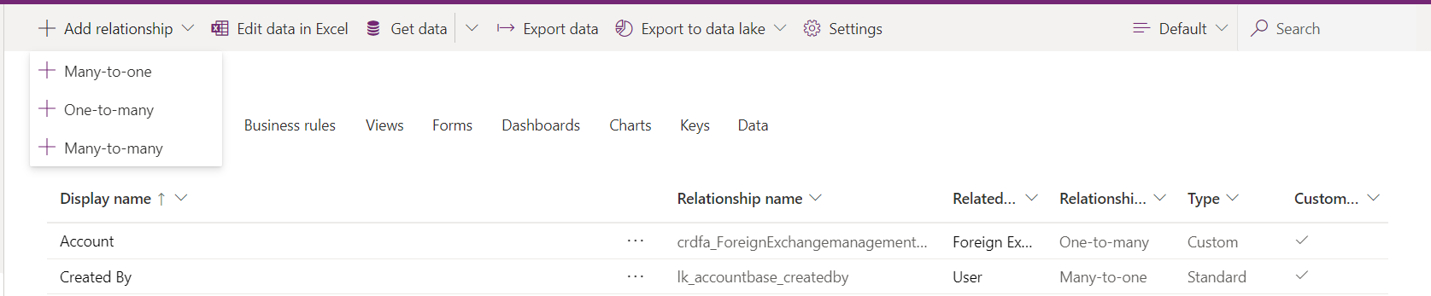
Relationship Management
Relationship management enable us to link entities to one another in a way that enables for effective data share and referential integrity.
There are 3 types : N:1, 1:1 & N:N

Slide 40






Venue (primary)
N:N
Events
Contacts
1:N
1:N
Hidden Intersect Entity
1:N
Events (related)

Slide 41




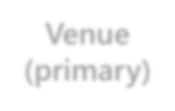

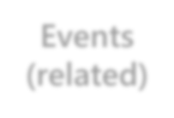
▪
▪
▪
▪
Venue (primary)
1:N
Events (related)

Slide 42






▪
▪
▪
▪
N:N
Events
Contacts
1:N
Hidden Intersect Entity
1:N
▪

Slide 43
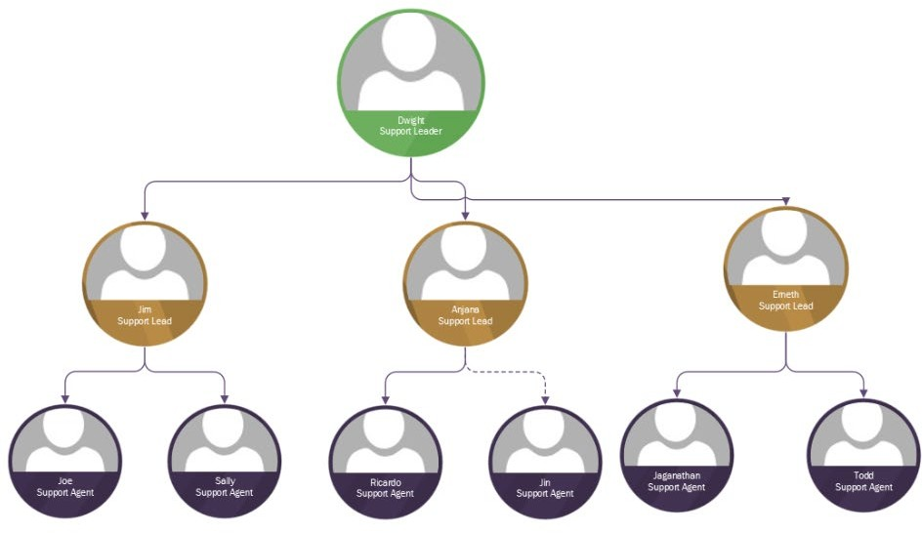


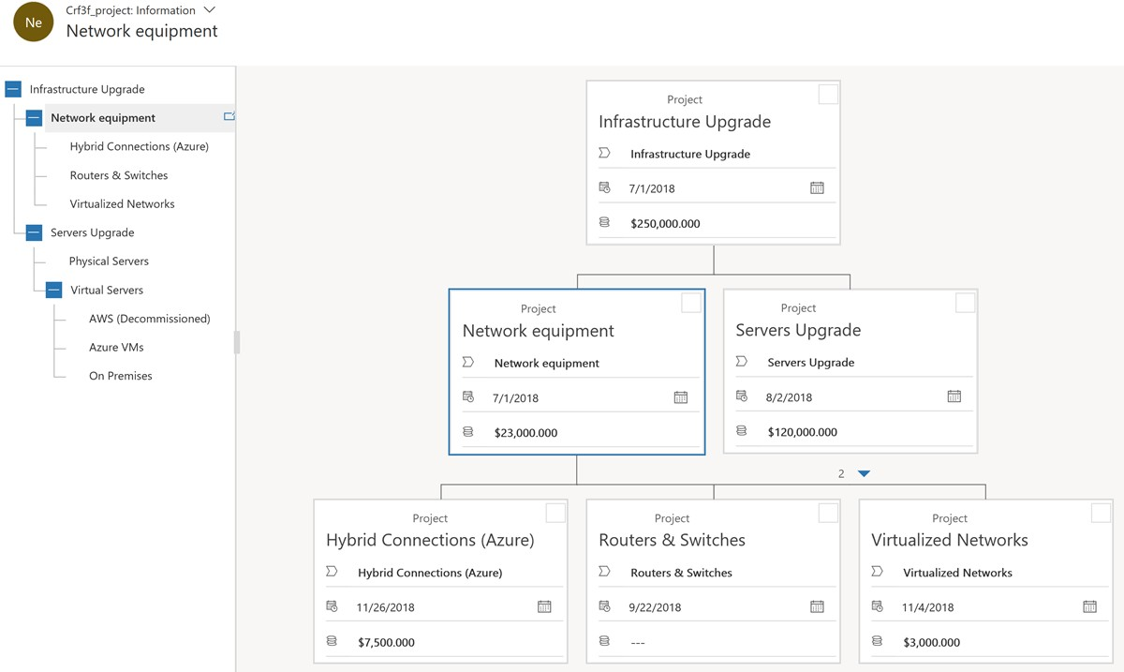





Slide 44
Relationships are Tough
Requirement : Track the language a contact speaks.

Slide 45
English
Contact John
Contact John
English
German
German
English
Contact Mary
Contact Mary
Spanish
Spanish

Slide 46
N: N Relationship
1: N Relationship
English
Contact John
Contact John
English
German
German
English
Contact Mary
Contact Mary
Spanish
Spanish

Slide 47
Contact John
Relationship Management : Many-To-Many (N:N)
Contact John
Language Spoken
English
Language Spoken
English
German
German
Spanish
Contact Mary
Language Spoken
Contact Mary
Spanish
Language Spoken

Slide 48
Manual N:N Relationship
N: N Relationship
Contact John
Contact John
Language Spoken
English
Language Spoken
English
German
German
Spanish
Contact Mary
Language Spoken
Contact Mary
Spanish
Language Spoken

Slide 49
Contact John
Connection Role
Connection Role
English
German
Contact Mary
Connection Role
Spanish
Connection Role

Slide 50
Feedback |  |  | Knowledge Assessment |  |  | Knowledge Question
 |  | N:1 |  |  | 1:N
 | 1:N |  |  | N:1
User |  |  | Knowledge Test Result
 |  | 1:N
1:N = One to Many N:1 = Many to One

Slide 51

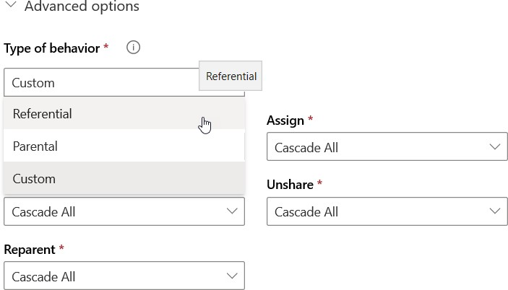
Control how certain actions cascade down to records related to the primary entity record through the 1:N entity relationship
Type of Behavior | Description
Parental | All actions use the Cascade All behavior.
Referential | Assign, Share, Unshare, and Reparent use the Cascade None behavior. Delete uses the Remove Link behavior. Merge uses the Cascade All behavior.
Referential, Restrict Delete | The same as Referential, except that Delete uses the Restrict Delete behavior.
Custom | Individual behaviors can be assigned for each action. If the choices match any of the other Type of Behavior categories, the value will change to that Type of Behavior value.

Slide 52
Parental
Feedback |  |  | Knowledge Assessment |  |  | Knowledge Question
 |  | N:1 |  |  | 1:N
 | 1:N |  |  | N:1
User |  |  | Knowledge Test Result
 |  | 1:N
1:N = One to Many N:1 = Many to One

Slide 53
Relationship Creation Demo

Slide 54
Too many entities, too many fields.
Avoid two options, if there might be more You are stuck with field formatting forever. Don’t build out parts of the data model you don’t plan to use.

Slide 55
Break

Slide 56
Security

Slide 57

▪
▪
▪
▪

Slide 58

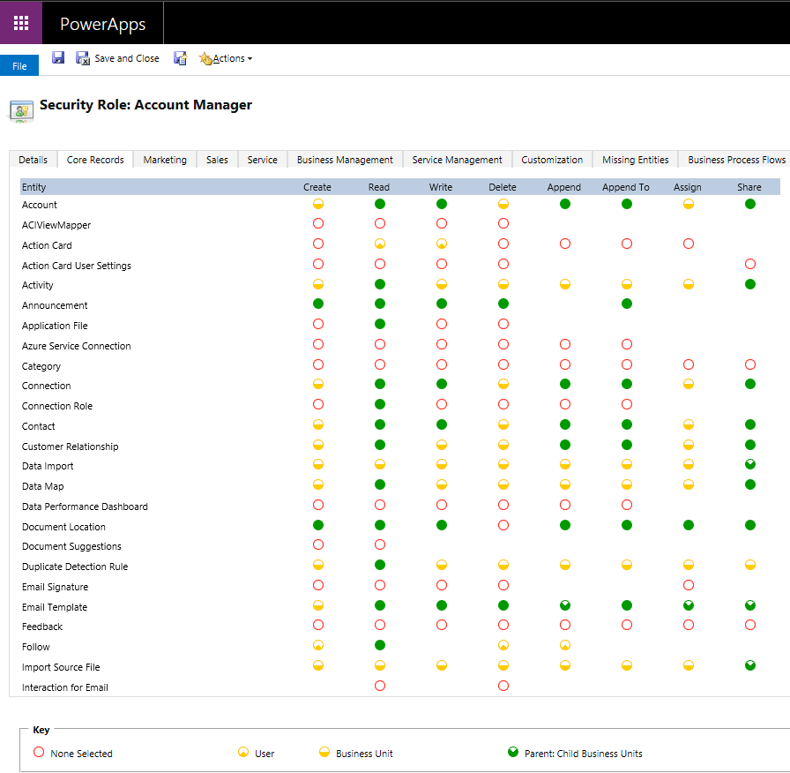





▪
▪
▪
▪
▪
▪
▪

Slide 59
▪
▪
▪
▪
▪

Slide 60
▪
▪
▪
▪

Slide 61



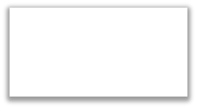
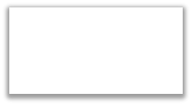

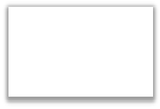

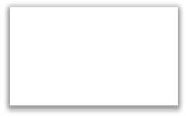
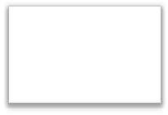

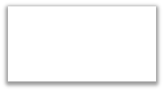


Company ABC
Root Business Unit
Sales
Customer Service
BU 1
BU 2
Chanel Sales
Support
BU 1.1
BU 2.1
Wholesale
BU 1.2

Slide 62
Scenario securing VIP Customers
Woodgrove Financial has one business unit and has given read access to all account-holders (contacts) to keep things simple
About 100 account-holders are VIP and need to only be seen by the assigned account manager
How can they handle this?

Slide 63

Before
After
Woodgrove
(Root Business Unit)
Woodgrove
(Root Business Unit)
Regular Customers
VIP Customers
Account #1
Account #1
VIP #1
Account #2
Account #2
VIP #1

Slide 64


Can own records
Can have security roles assigned
Scales up to 1,000 teams
Good when membership is pretty static
Record owned by organization
Members must have permissions
Scales over 1,000 teams
Can be dynamically created per record with a access template

Slide 65

▪
▪
▪
▪
▪

Slide 66


▪
▪
▪
▪
▪

Slide 67
Lab 1 : Data Modelling

Slide 68
Data Flows

Slide 69
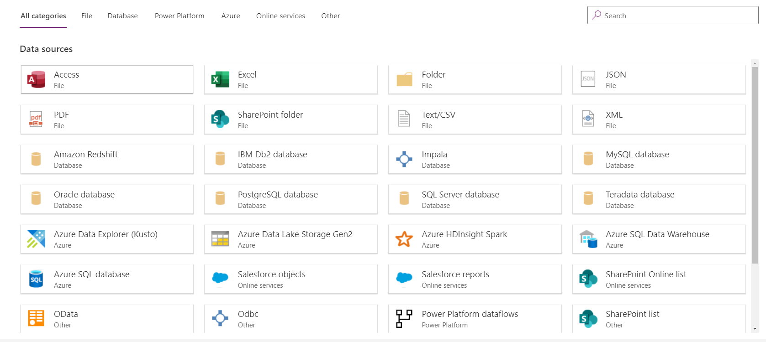
Data Flows
Dataflows are a mechanism to get data into the Common Data Service from Various Sources.

Slide 70

Record
Management
Process
Record Management Model App
Power Apps
Common Data Service for Apps
Custom Entity
Data
Views
Graphs
Relationships
Forms
Fields

Slide 71
Model Driven App Components

Slide 72
Model Driven App Components

Slide 73

The data model is the foundation you are building your solution on – take time to make it solid
Consider more than one approach to data model
Use proof of concepts to test ideas
Take advantage that CDS is good at incremental data modelling
Build your data model so you can manage it with available security features

Slide 74

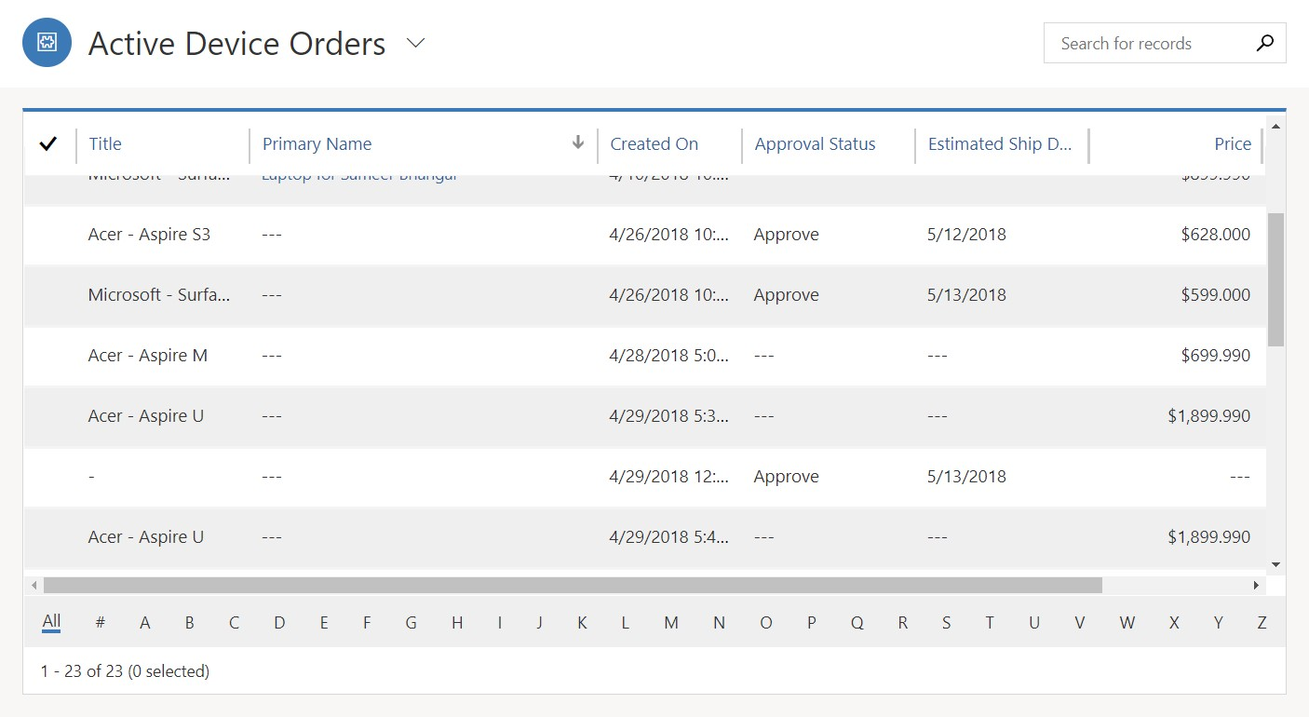



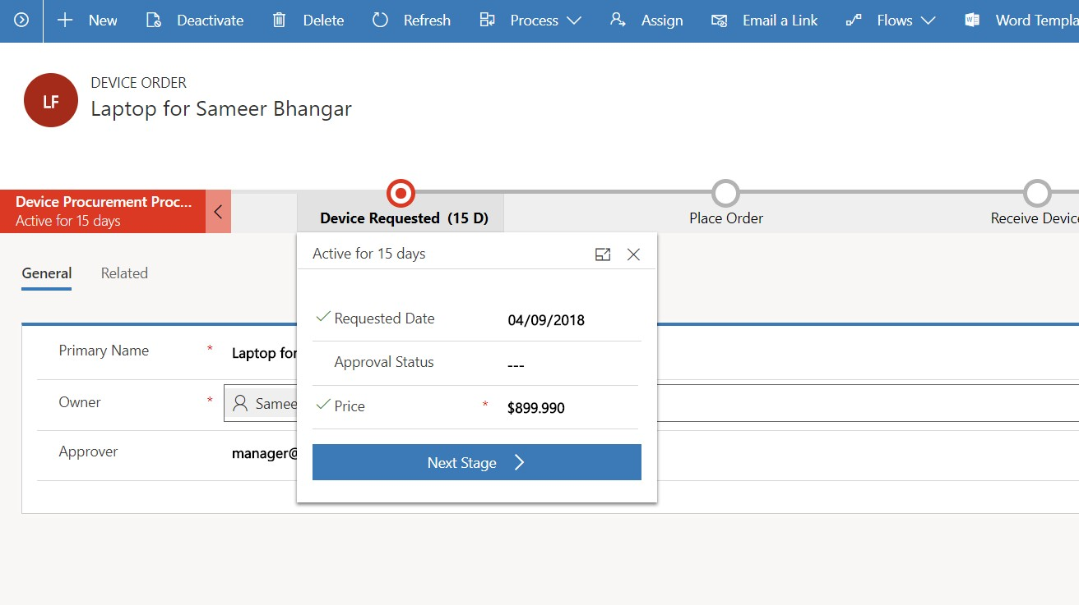
List and forms over data
Consistent experience across apps and devices
Easy to build with configuration first approach
3

Slide 75































Slide 76

Business Process Flows
Site Navigation
Dashboards
Forms
Views
Charts

Slide 77

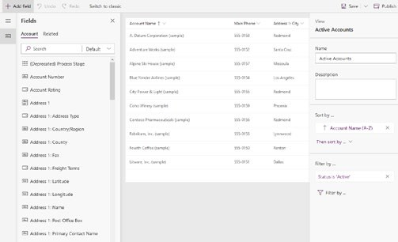
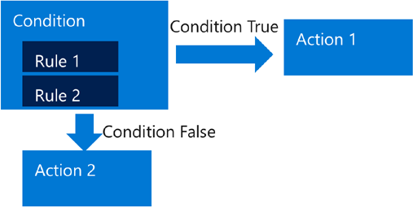
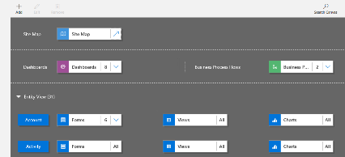
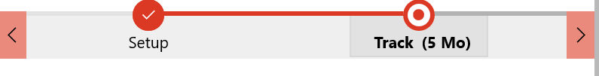
Create Forms, Views and Dashboards
Build the Data Model
Build Business Rules
Build Process Flows
Compose the App
Inspections
Owners
Notes
Plans

Slide 78
Forms

Slide 79
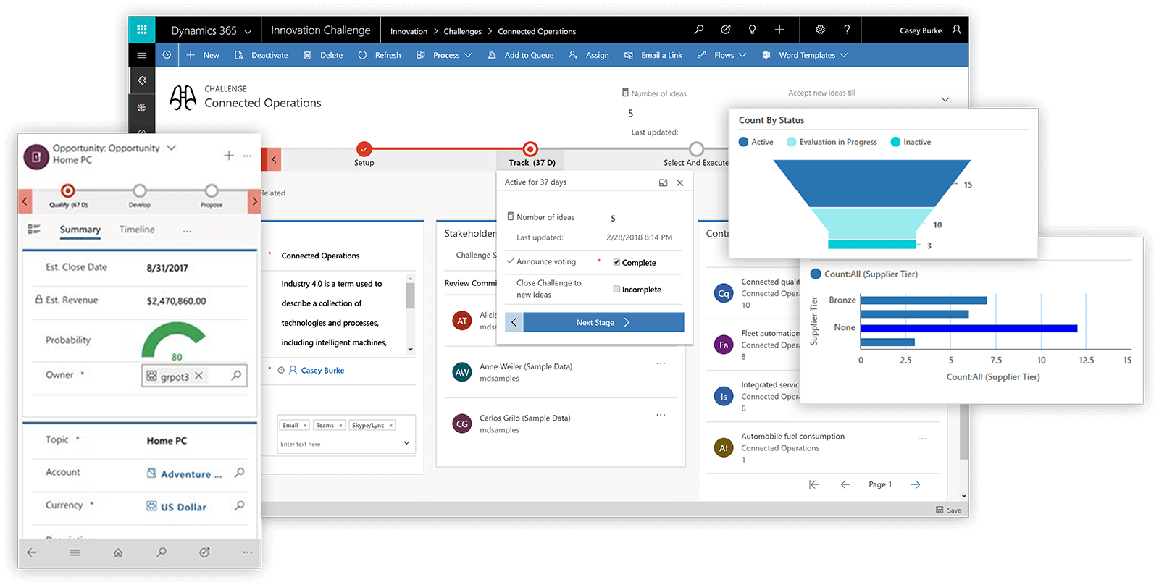
What are Forms
Forms are a mechanism for users to both input data and view data from both the primary record and the associated records.

Slide 80







Slide 81


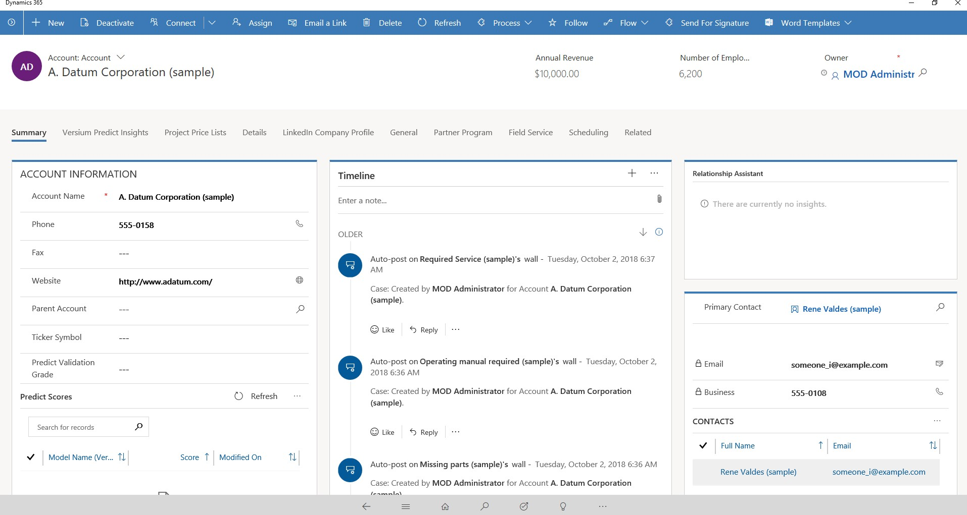

Slide 82


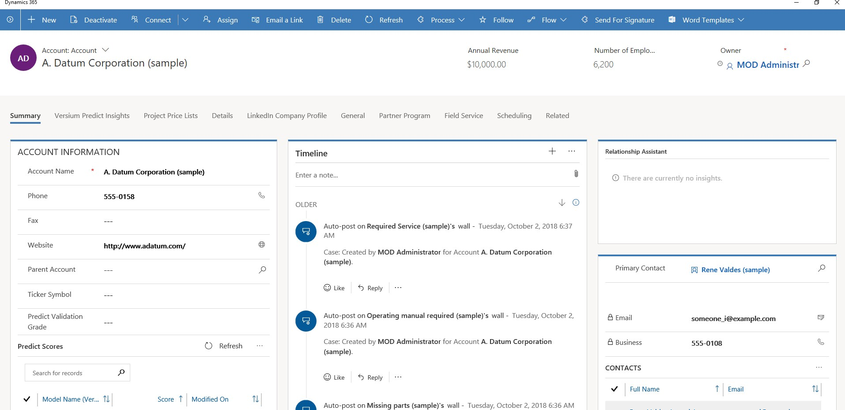

Slide 83


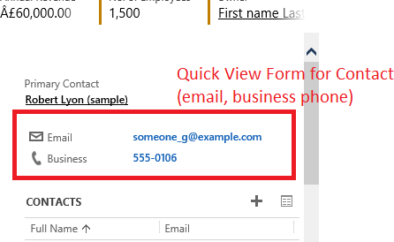
Surfaces key information from the parent on child record through configuration
Should be used sparingly:
Key information only, not for showing entire record
Use when information directly actionable or related to outcome driven from parent record
Can have different quick views for different related entities/forms

Slide 84
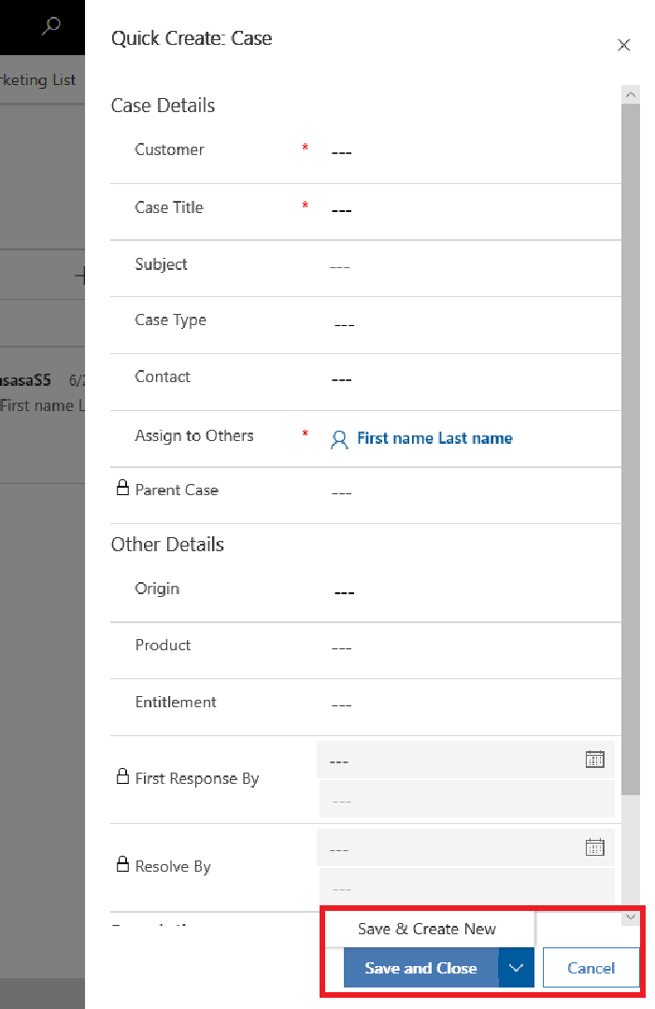

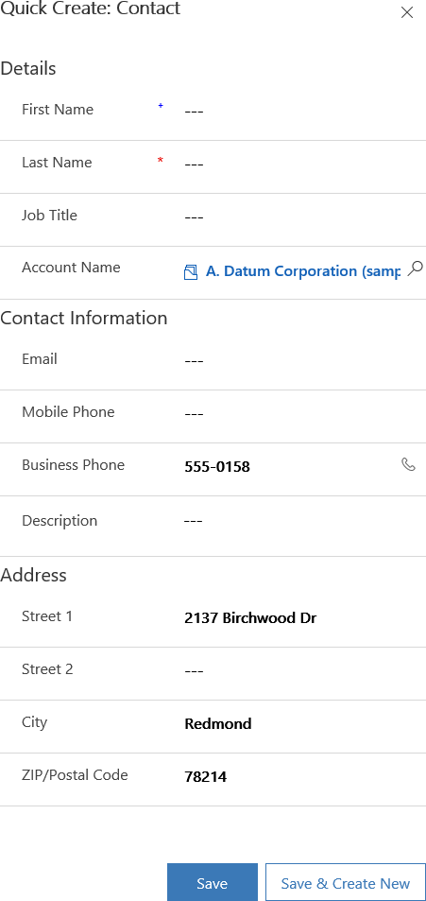

Slide 85

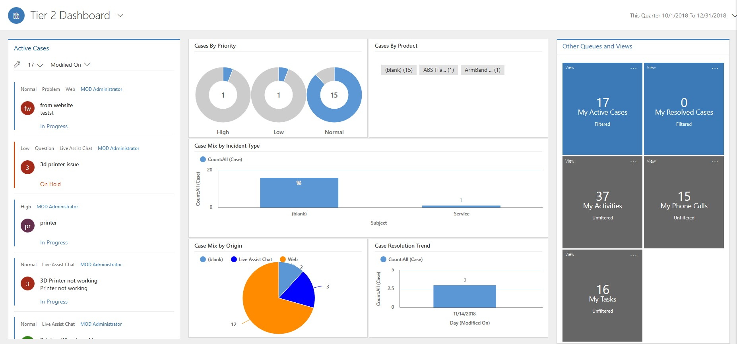

Slide 86
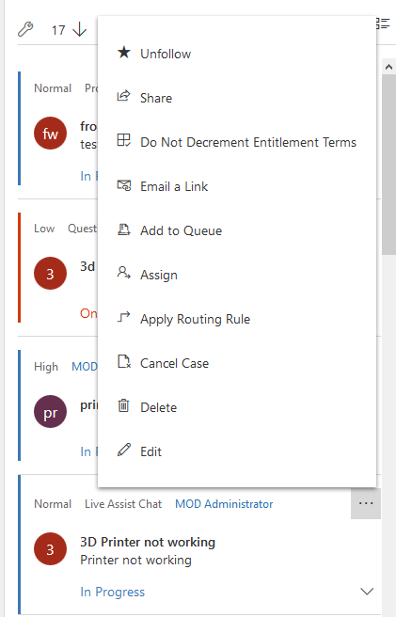

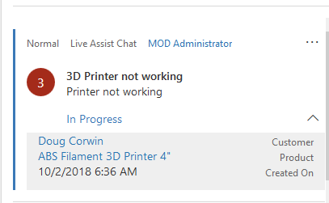

Slide 87
Forms Demonstration

Slide 88
Views

Slide 89

What are Views
Forms are a mechanism to view lists of data across single or multiple entities within the solution.

Slide 90
View Types
System Views are views that are created by the admin for the system and for users to interact with should they have the correct security.
Personal Views are views created by a user for themselves and can be shared across to other users if necessary.
Views respect security roles.

Slide 91


Related Entities
Sub grids
Displayed directly on parent form
Can be filtered to control presented data
Views can be added
Can impact form performance
Accessible from navigation
Views can be added
Can impact form performance

Slide 92



List View
Grid View

Slide 93



Slide 94
Views Demonstration

Slide 95
Charts

Slide 96

What are Charts
Charts are a mechanism to view data in a graphical format that is easy to analyse and consume.

Slide 97

Chart Types
There are multiple different types of charts that can be leveraged to view and analyse data. These charts are real time and will display information as it is captured directly within the Common Data Service
Typical Chart Types are:
Bar Charts
Column Charts
Pie Charts
Funnel
Area
Line

Slide 98
Charts Demonstration

Slide 99
Lab 3 : Model Driven App Components

Slide 100
Model Driven Apps & Business Process Flows

Slide 101
Model Driven Apps

Slide 102







Power Apps: a low-code approach to building apps
Easily build web & mobile apps with a full featured low-code / no-code platform
Combine a PowerPoint-like designer with Excel functions and you have PowerApps!
Connect to your existing data with 260+ pre-built connectors and custom connectors
Strong enterprise governance & security
Leverage device features such as camera, GPS and microphone with no code!
Pro-dev extensibility enable “no limits” development
Notes:
Chris
And as a quick refresher – PowerApps is all about providing a low-code way to rapidly build apps for mobile and the web. We make it easy to connect to your existing data, with over 250 pre-built connectors, as well as the built-in Common Data Service. All of this speed does not compromise on power, though- PowerApps is all about strong enterprise governance and security, and has a bunch of professional developer hooks.
Easily build apps with a full featured low-code / no-code platform
Connect to all your data with pre-built connectors, custom connectors
Put your data to work with the Common Data Service for Apps
Streamlined Office 365, Azure, Dynamics 365, Power BI, Microsoft Flow integration
Strong enterprise governance & security
Pro-dev extensibility

Slide 103
Create Forms, Views and Dashboards
Build the Data Model
Build Business Rules
Build Process Flows
Compose the App
Inspections
Owners
Notes
Plans

Slide 104





▪
▪
▪

Slide 105




Slide 106


Wave 2 Feature

Slide 107


Wave 2 Feature

Slide 108


Wave 2 Feature

Slide 109



Slide 110


Slide 111
▪
▪
▪
▪

Slide 112

Customize by changing the SiteMap
Navigation is a result of the merged SiteMap from all solutions
Area and groups are containers
Subareas point to entity , web resource or URLs
Security will trim items, can also trim by removing item
Site Map Structure
Area
Group
Group
Subarea
Subarea
Subarea
Subarea
Area
Group
Group
Subarea
Subarea
Subarea
Subarea

Slide 113



▪
▪
▪
▪

Slide 114

Model-driven apps provide the fastest path to getting an app up and running on CDS data
Unified Interface runtime provides a consistent and accessible user experience across apps and devices
86

Slide 115
Model Driven App Demonstration

Slide 116
Business Process Flows

Slide 117


















Slide 118

Conditional branching
A guide, roadmap, recipe, …
Stages and steps
Stage gating
Include multiple entities
Switch at any time
Role tailored
Automation and Developer APIs

Slide 119


Slide 120


Slide 121











▪
▪
▪
▪
▪
▪
▪
▪

Slide 122

Open inspection
Open permit
Assign and schedule
Open parent
inspection
Close permit
Assign and schedule
Assign and schedule
Must pass prior
Assign and schedule

Slide 123
Business Process Flows Demonstration

Slide 124
Lab 4 : Model Driven Apps & Business Process Flows

Slide 125
End! Thank you

